Slide 1




KaggleX BIPOC 2023
Notes:
Recommending picking out he most interesting and important parts from your documentation.

Slide 2

Sneha
Kumari

Slide 3
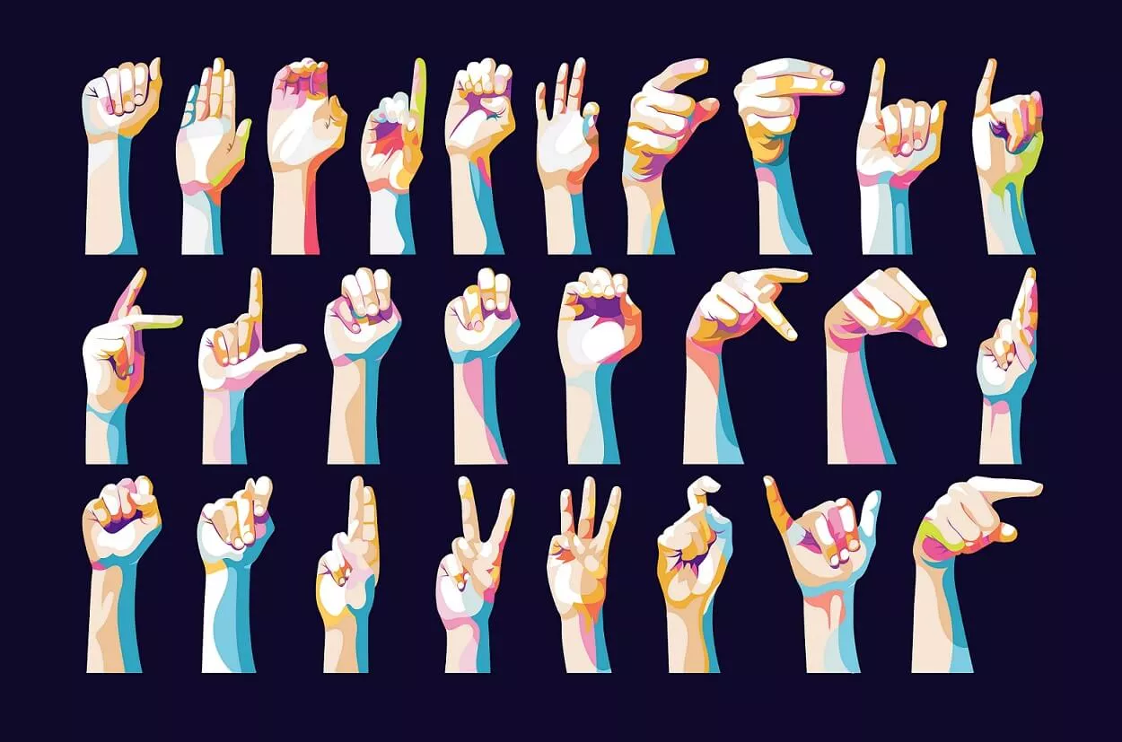
Google - Isolated Sign Language Recognition
Enhancing PopSign's educational games
for learning ASL
(current ongoing competition)
Research Code Competition

Slide 4
Background
Academic Background:
I am a third-year undergraduate student from the Department of Industrial and Systems Engineering, IIT Kharagpur, India.
I have done Deep Learning Summer School at Neuromatch where I worked on Paraphrase generator models, fine tuning the T5-base transformer designed by the Google Brain team on the PAWS dataset for accurate paraphrase generation.
I have been trained in Deep learning and tensorflow during Google ML Bootcamp.
Notes:
reduce details

Slide 5
Background
Current line of work/ aspirations:
I intend to work towards writing an accomplished research paper, a motive of pursuing higher studies abroad and build a career in deep learning.
Currently, I am focusing to work on diverse and challenging projects that allow me to apply my skills and creativity to make data-driven decisions and drive business value.
Slowly and gradually, I want to develop expertise in a specialized domain of AI, therefore I'm attempting to figure out what areas most endear to me.

Slide 6
Project Definition
Project Summary
This contest's objective is to categorise isolated American Sign Language (ASL) signs.
In the United States, 33 infants are born every day with irreversible hearing loss. 90% of them are born to hearing parents, many of whom are not even familiar with American Sign Language.
Learning American Sign Language is as difficult for English speakers as learning any other language.
Hence, PopSign has come up with a smartphone game app that makes learning American Sign Language fun, interactive, and accessible.
Notes:
Wyoming EHDI

Slide 7
Project Definition
How ASL Recognizer is helpful?
Players match videos of ASL signs with bubbles containing written English words to pop them.
By adding a sign language recognizer from this competition, PopSign players will be able to sign the type of bubble they want to shoot, providing the player with the opportunity to practice the sign themselves instead of just watching videos of other people signing.
Hence, this competition required development of a TensorFlow Lite model that has been trained using labelled landmark data that was obtained using the MediaPipe Holistic Solution.

Slide 8
Project Definition
Dataset Card for the Isolated Sign Language Recognition Corpus
The Isolated Sign Language Recognition corpus (version 1.0) is a collection of hand and facial landmarks generated by Mediapipe version 0.9.0.1 on 94,477 videos of isolated signs performed by 21 Deaf signers from a 250-sign vocabulary.
The dataset includes 3 directories constituting 56GB in total:
train_landmark_files(21 directories) - Each subfolder contains around 3k-5k .parquet files named after the sequence IDs.
sign_to_prediction_index_map.json - [0-249] mapping of literal sign value to integer value.
train.csv - contains 94,477 unique paths with participant_id, sequence_id and the corresponding sign label (out of 250 unique values).
Notes:
The dataset provided by Deaf Professional Arts Network and the Georgia Institute of Technology.

Slide 9
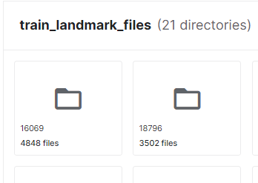
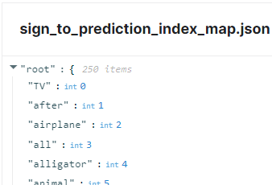
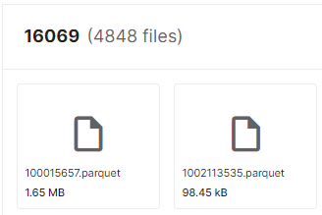
Project Definition
Dataset

Slide 10
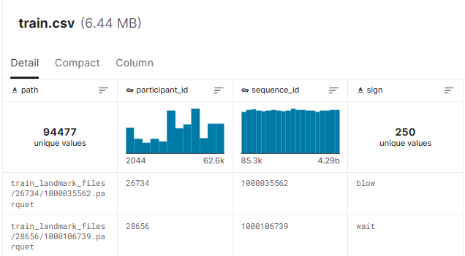
Project Definition
Dataset

Slide 11
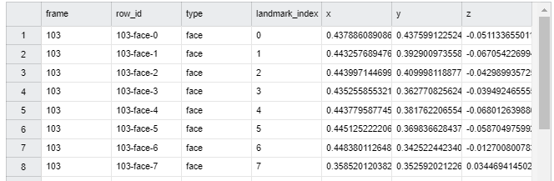
Project Definition
Parquet file
Each parquet file contained varying length of number of frames which was the ultimate challenge.

Slide 12
Project Definition
Problem with the data :(
Variable input length
-> Created ragged batches
Varying number of frames per parquet file(i.e. sign)
-> Ragged batch contained 3 frames per row
Nan data
-> Filled with zeroes and padded

Slide 13
Project Definition
Data Science Topic(s) Applied
Data pre-processing
Exploratory Data Analysis
Feature engineering
LSTM
Hyperparameter tuning
Transfer learning
Conversion of Tensorflow model to TFlite

Slide 14
Project Definition
What I learned
Techniques for data pre-processing for variable length input data like dealing with missing values, handling outliers, encoding categorical variables, scaling numerical variables, and more.
Exploratory Data Analysis (EDA)on sequential data to uncover patterns, relationships, and trends and helps identify outliers, missing values, and other issues with the data.
Creating new features, transforming existing ones(mean and std_dev) to improve the performance of machine learning models.
Use of LSTMs in case of solve sequential data.
Techniques for transfer learning include fine-tuning pre-trained models, using feature extraction, and more.

Slide 15
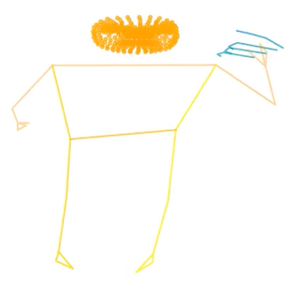
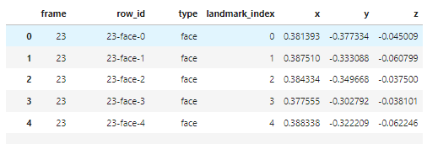
EDA Results:
-> Conversion of
tabular data to
video for 3D visualization ->

Slide 16
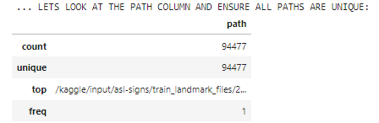
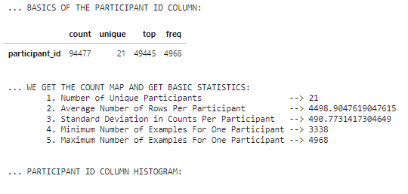
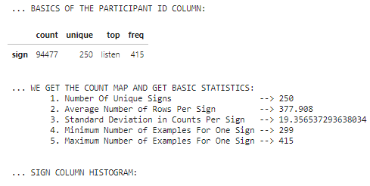
EDA Results

Slide 17
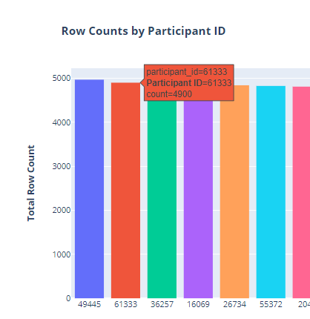
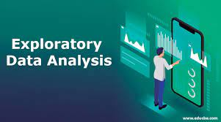
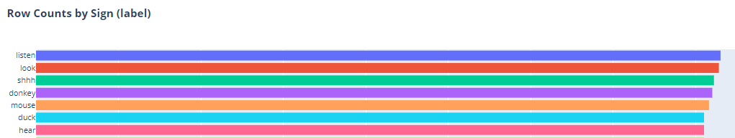
EDA Results

Slide 18
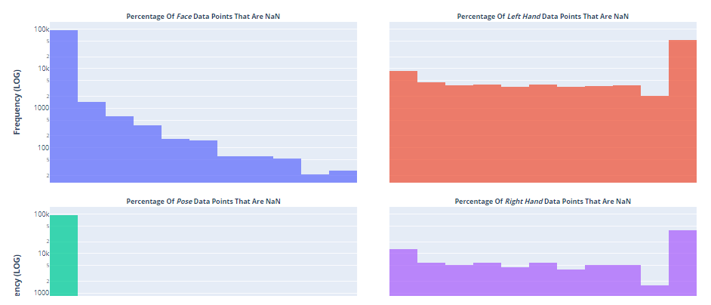
EDA Results

Slide 19
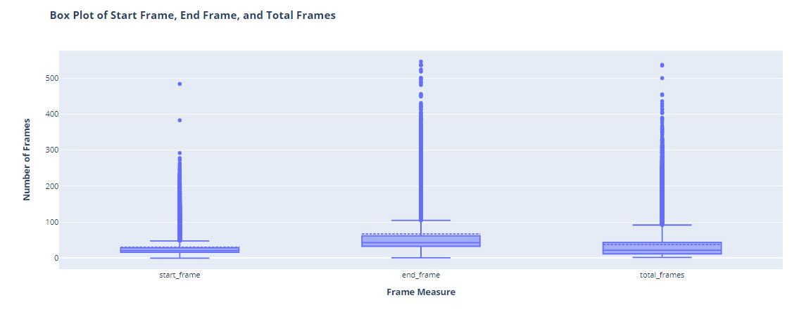
EDA Results

Slide 20
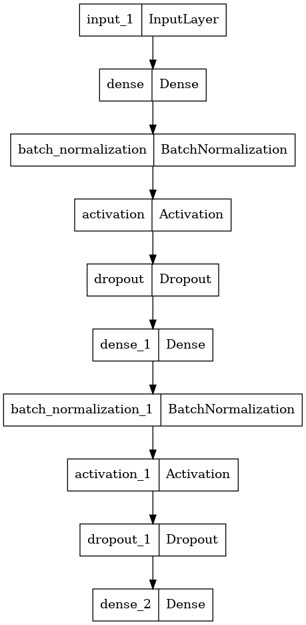
SIMPLE DNN MODEL

Slide 21
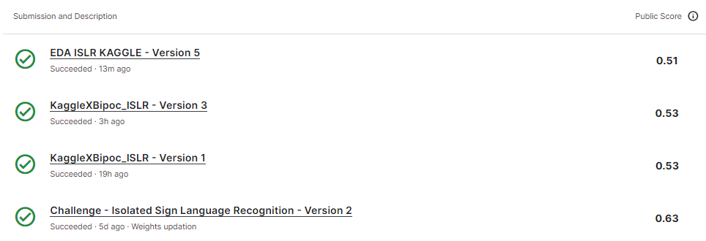

Project Details
Results:
<- DNN Model with 1 dense layer - most basic model using only
hand landmarks
<- LSTM model
<- Transfer Learning model with feature
extraction

Slide 22
Project Details
Future Work
Lookout for other models for accuracy improvement
Exploration of more features that could help detect sign more efficiently and accurately.
Trying out pipeline of LSTM and transfer learning model.

Slide 23
Project Details
Notebook Links
https://www.kaggle.com/code/snehaiitkgp/eda-islr-kaggle
https://www.kaggle.com/code/snehaiitkgp/kagglexbipoc-islr/notebook
https://www.kaggle.com/code/snehaiitkgp/challenge-isolated-sign-language-recognition/notebook

